Slide 1
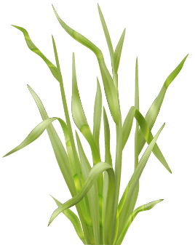
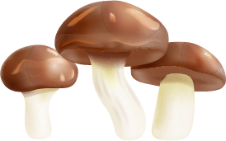

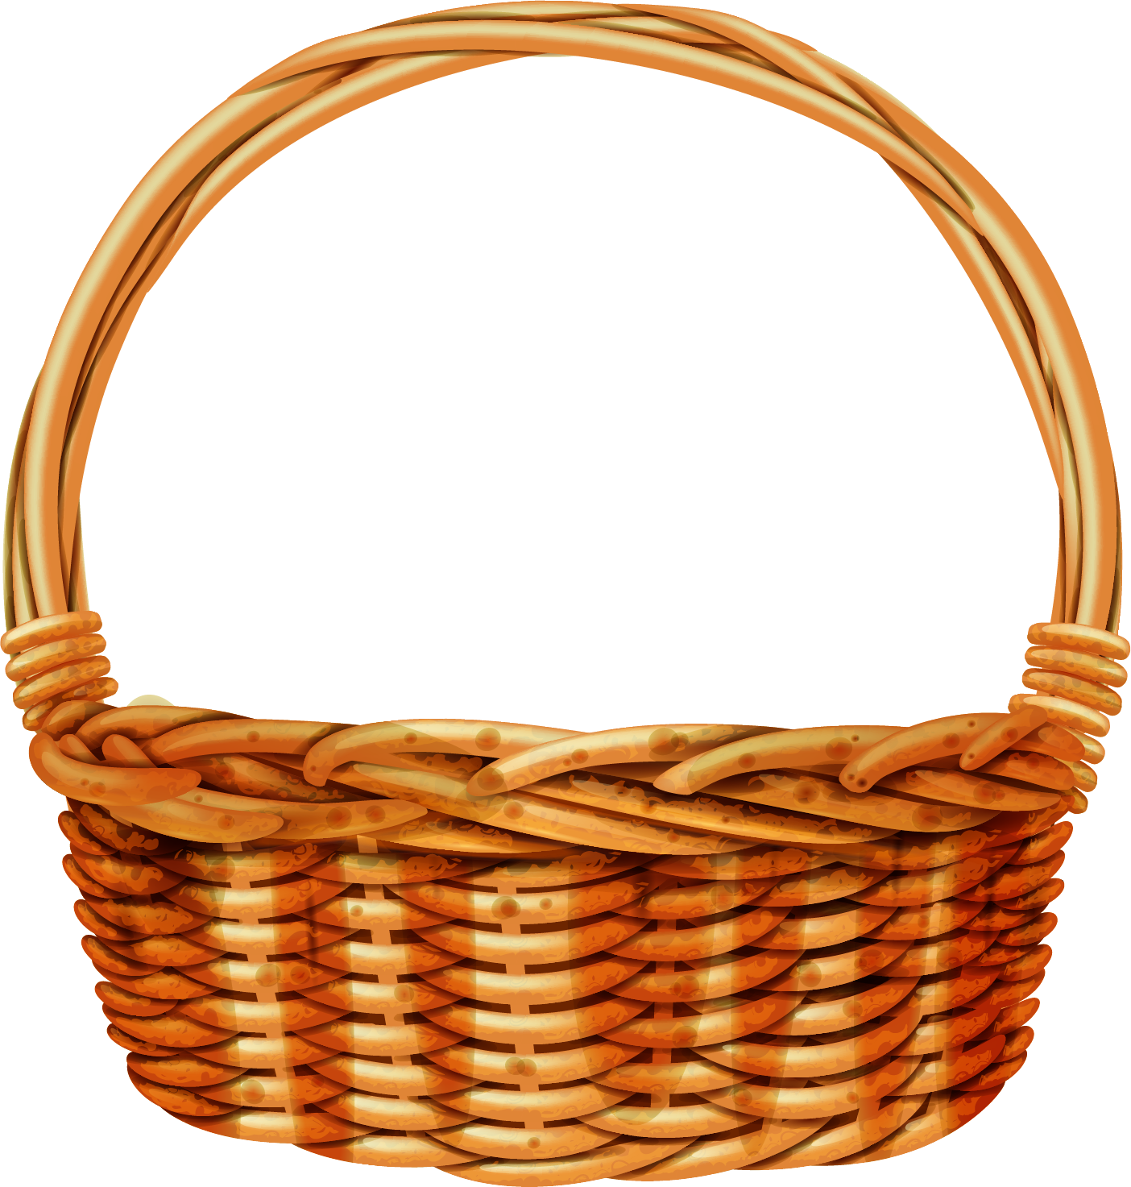
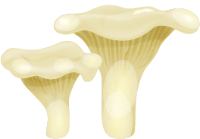
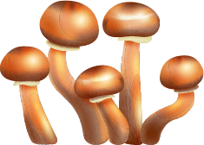
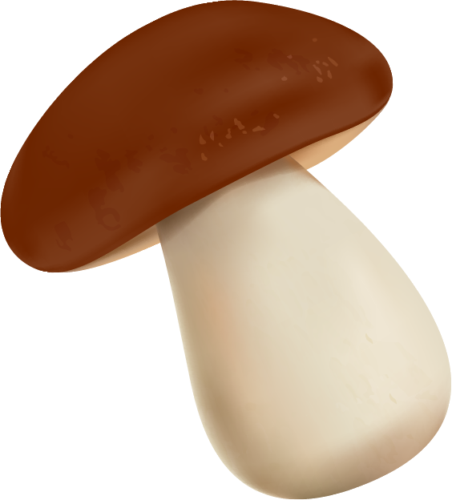
Mushroom Toxicity Identification
Sino Dragon

Slide 2
Table of contents
01
02
03
04
05
06
Our Team
Business
Data Explanatory
Model
Application
Conclusion

Slide 3
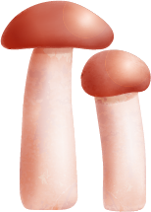
01
Our Team

Slide 4

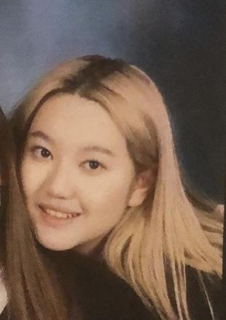





Our Team
Changhao Zhang
Ningxin Kong
Xusen
Shi
Yichao
Ma
Yifan
Han
Hongxuan
Zhao
Yuheng
Bai

Slide 5
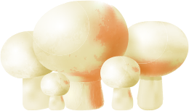
02
Business

Slide 6
Poisoning Incidents
Number of accidents：10,036
Number of persons: 38676
40%
2.04%
71%
Yunnan
Lethality rate
Incidence Rate
Yunan had 4,010 accidents, and 40% of whole country

Slide 7
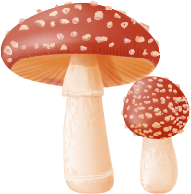
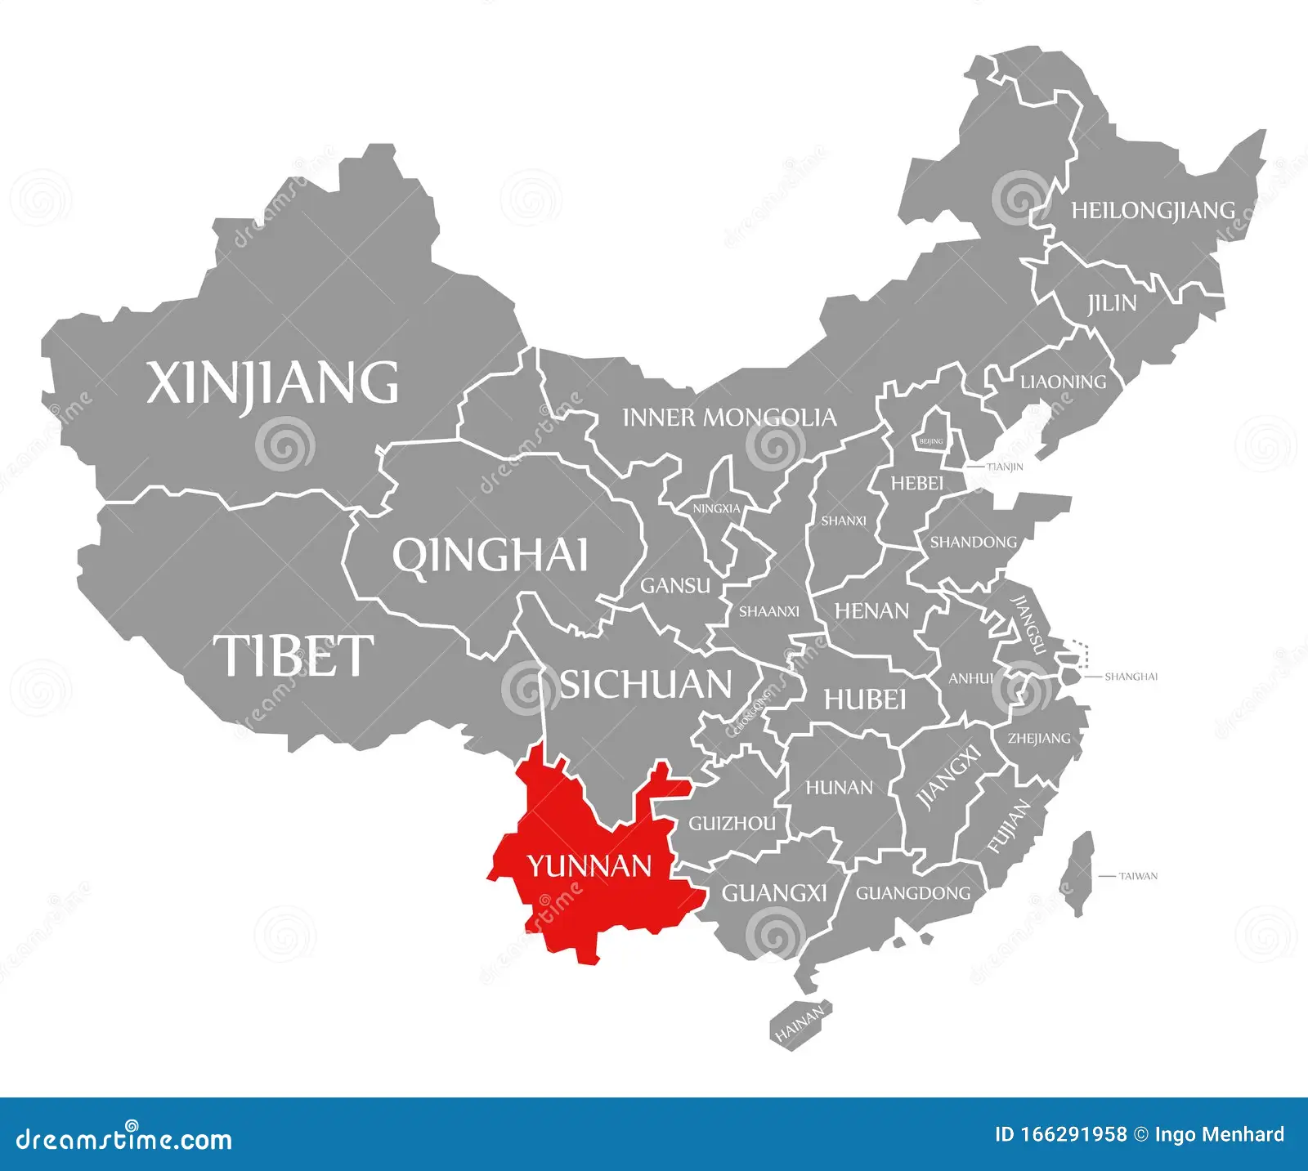
Our Client
· Collaboration with the Yunnan government
· Improvement of villagers' ability to recognize the toxicity of mushrooms and reduction of accidents

Slide 8
Strategy
Convenience
01
Application Development
2024
Versatility
02
Based on signs observed by people
Results
03
Provides results for specific mushroom

Slide 9
03
Data Explanatory

Slide 10
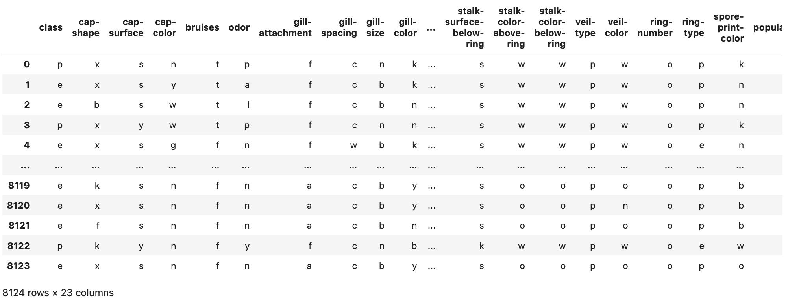
Mushroom Data Overview
Source: "The Audubon Society Field Guide to North American Mushrooms" (1981)
Features: Mushroom features such as cap shape, cap surface, gill shape, stalk shape, and many others. All features are categorical
Classes:
Edible
Poisonous
General: There are 8123 observations of mushrooms with no null value(s) present in each column

Slide 11
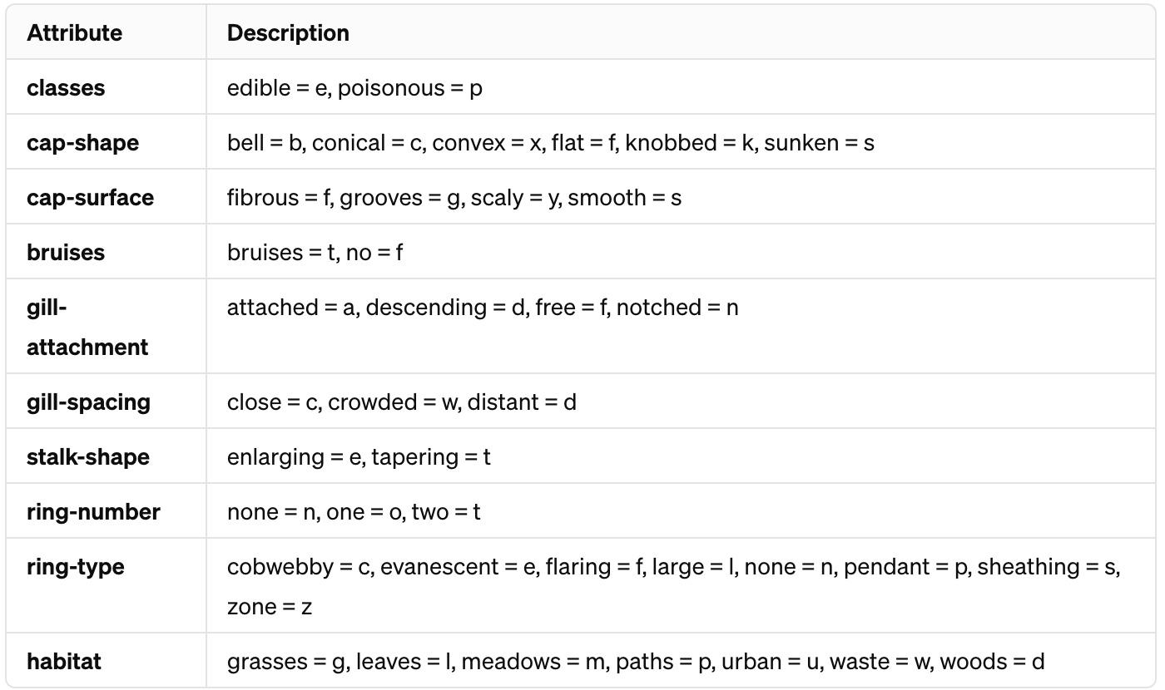
Feature Selection
Attribute Description
Out of 22 features, 9 features that are most visually apparent and relevant are selected
Cap Features: Shape and surface
Gill Features: Attachment, spacing
Stalk Feature: Shape
Ring Features: Number and type
Bruises: Presence or absence
Habitat: Type of surrounding environment where the mushroom is found

Slide 12
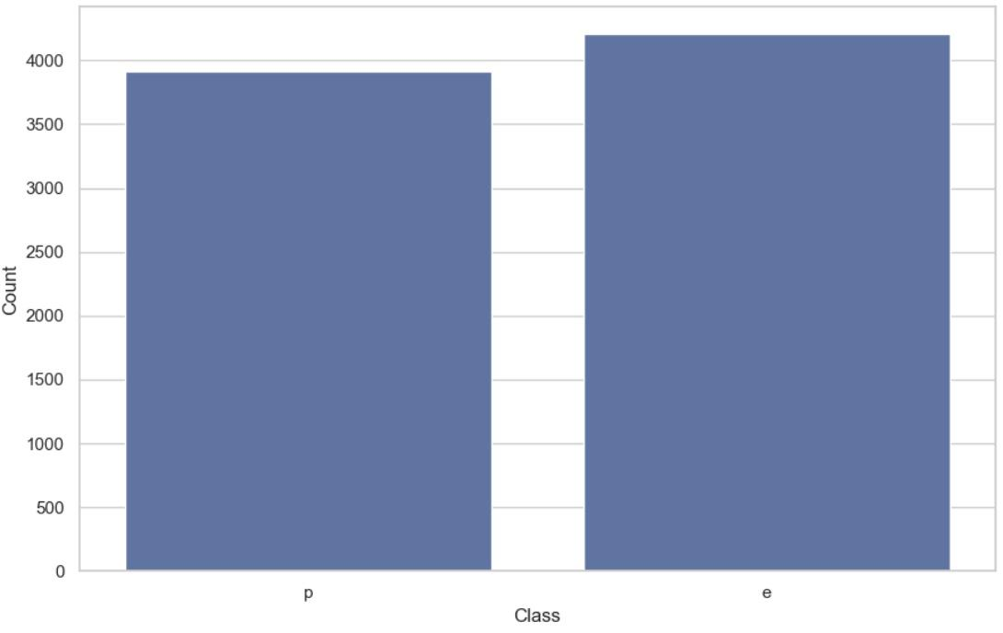
Mushroom Data: Proportion of Edible vs. Poisonous Mushrooms
4,208 edible (e) and 3,916 poisonous (p) mushrooms
Fairly balanced dataset
Beneficial for modeling since it helps prevent a model from being biased towards the more frequent class

Slide 13
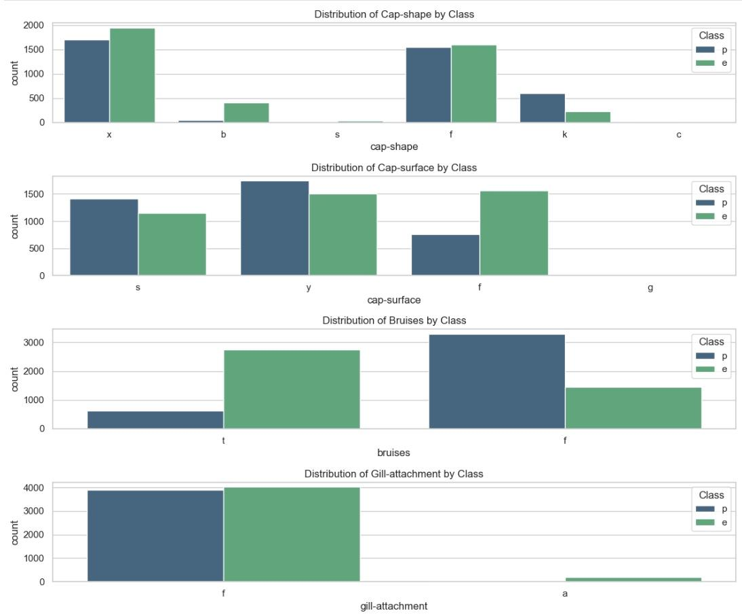
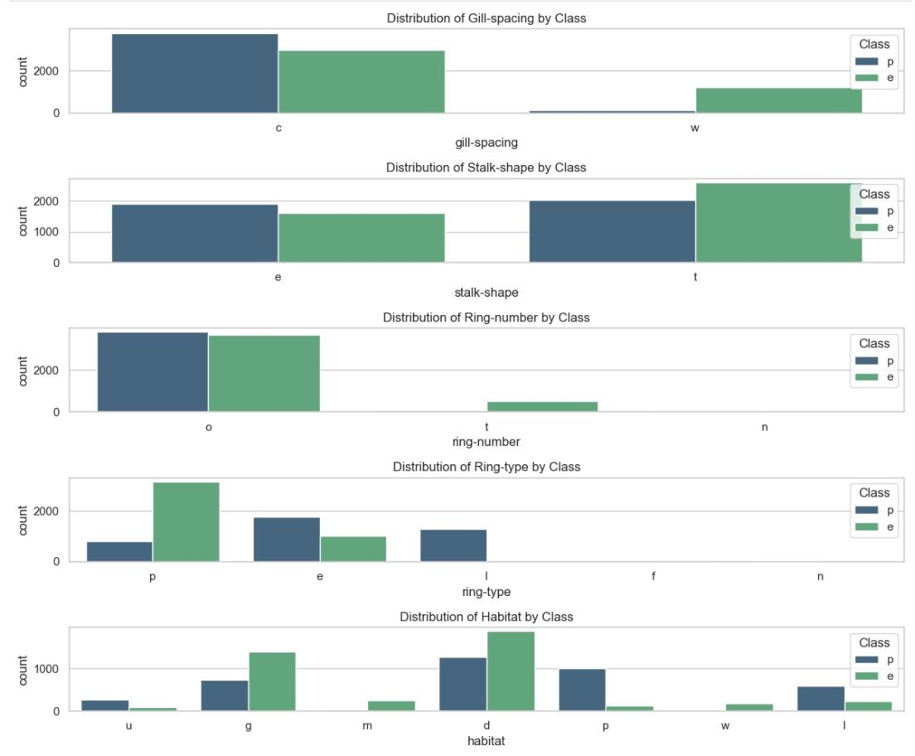
Mushroom Dataset: Exploring Mushroom Characteristics

Slide 14
Mushroom Dataset: Exploring Mushroom Characteristics (Cont.)
Cap Characteristics: Variability in cap shape and surface suggests these attributes could be significant in differentiating between classes, with certain types possibly leaning towards one class over the other
Bruises: The occurrence of bruises on mushrooms appears to be a prominent feature that could be used to distinguish between edible and poisonous classes, with one class showing a higher tendency towards bruising
Gill Attachment: The type of gill attachment, especially the free type, is indicative of the mushroom's class, highlighting its potential as a strong predictor in classification tasks
Gill Spacing: The space is distinctly distributed between the classes, suggesting it is informative for predicting whether a mushroom is edible or poisonous
Stalk Features: The shape of the stalk show differences between classes
Ring Characteristics: The number and type of rings offer valuable clues; no rings or two rings suggest edibility, whereas one ring may suggest toxicity. Moreover, pendant rings are commonly found on edible mushrooms
Habitat: The habitat of a mushroom is a significant factor, with urban and wooded areas more likely to harbor poisonous varieties, and grassy areas and meadows more likely to have edible ones
Takeaway: The distinct distribution of cap characteristics, bruises, gill attachment and spacing, stalk features, ring types, and habitat environments provides critical insights, making these attributes highly effective for distinguishing between edible and poisonous mushrooms in classification tasks

Slide 15
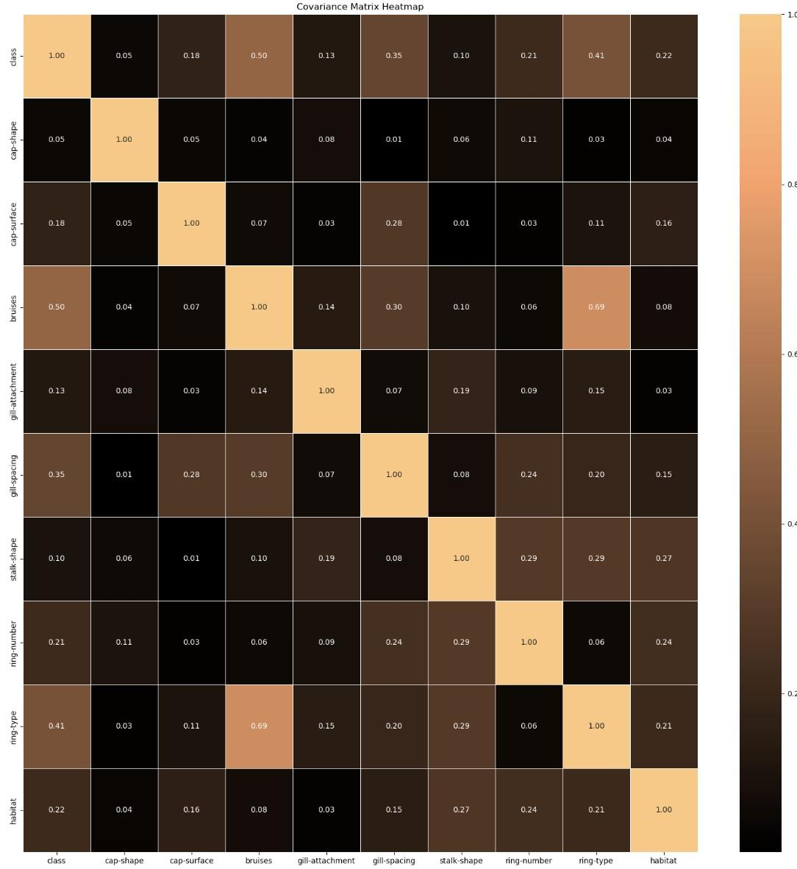
Mushroom Dataset: Covariance Matrix Heatmap
Class Correlation:
Key predictors: bruises have a notable correlation with class
Multicollinearity Concerns:
Ring-type and bruises have high correlation
May impact models that assume feature independence

Slide 16
04
Model

Slide 17
Training Steps
Split into training set and testing set
Training set: 0.8
Testing set: 0.2
Encode and standardize categorical Variable
Model candidates: Decision Tree, Random Forest, Boost Tree, SVM
Hyperparameter Tuning
Scorer: Negative Predicted Value
We want to minimize the probability of being poisonous given predicted as edible
Decision Tree Parameters
Criterion: gini, entropy
Maximum depth: none, 1, 2, 3, 4, 5
Random Forest Parameter:
Number of Estimators: 10, 50, 100, 150
Maximum depth : none, 1, 2, 3, 4, 5
Boost Tree Parameters:
Number of Estimators: 10, 50, 100
Maximum depth: none, 1, 2, 3, 4, 5
Learning Rate: 0.01, 0.1, 0.2, 0.5
SVM Parameters
Cost: 0.1, 1
Gamma: 1, 10

Slide 18
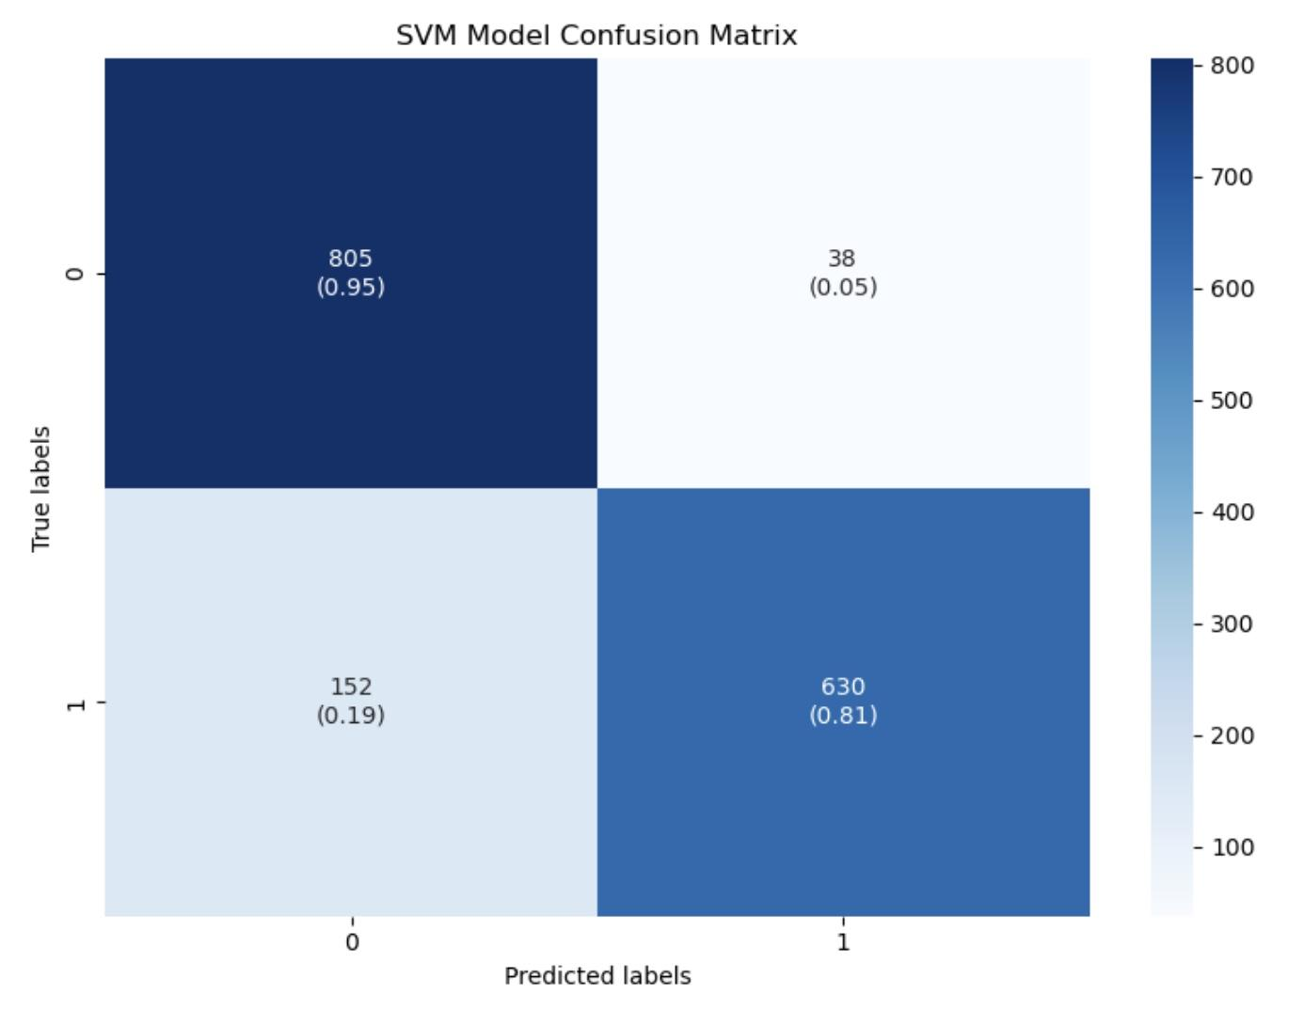
Best Support Vector Machine
Best parameters
Regularization: 1
Gamma: 1
Kernel: Linear
Accuracy = 0.90
Negative Predicted Value = 0.806

Slide 19
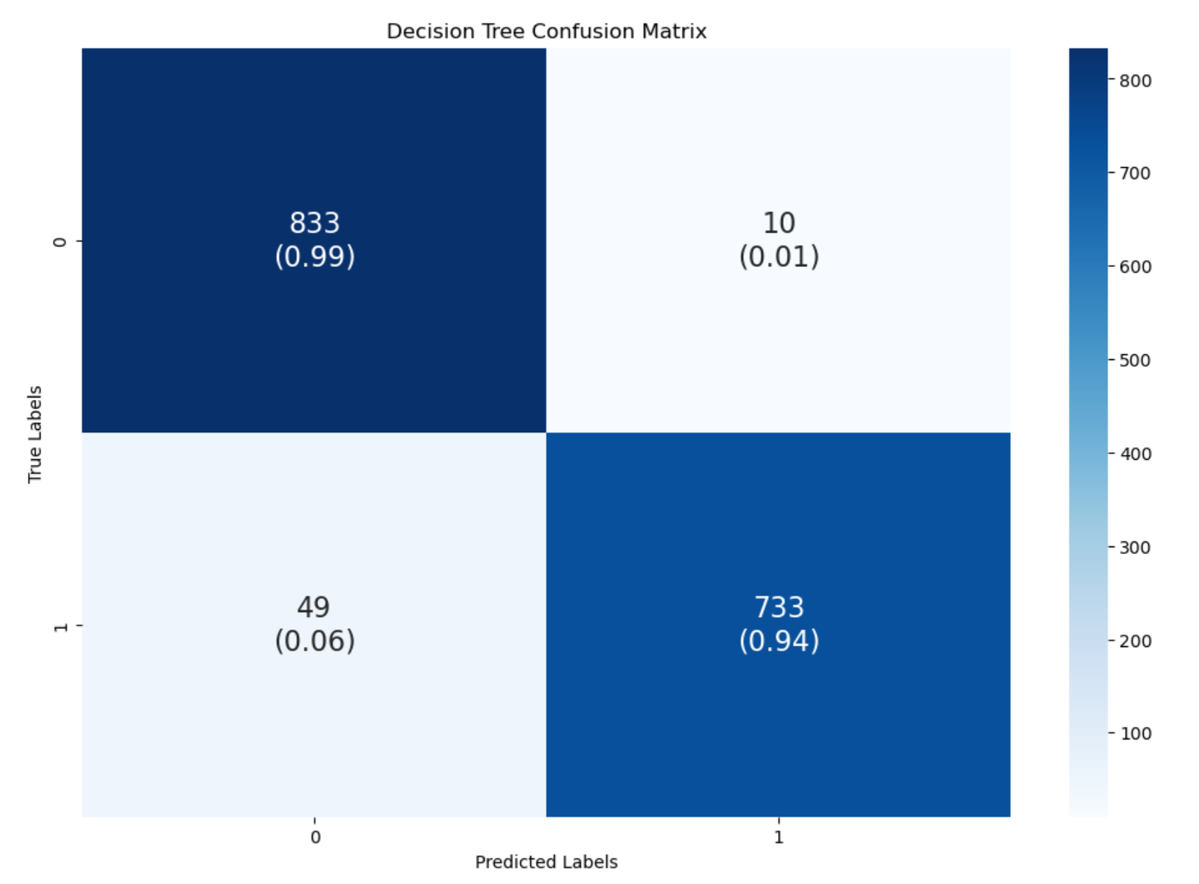
Best Decision Tree
Best parameters
Criterion: gini
Maximum depth:5
Accuracy = 0.95
Negative Predicted Value = 0.944

Slide 20
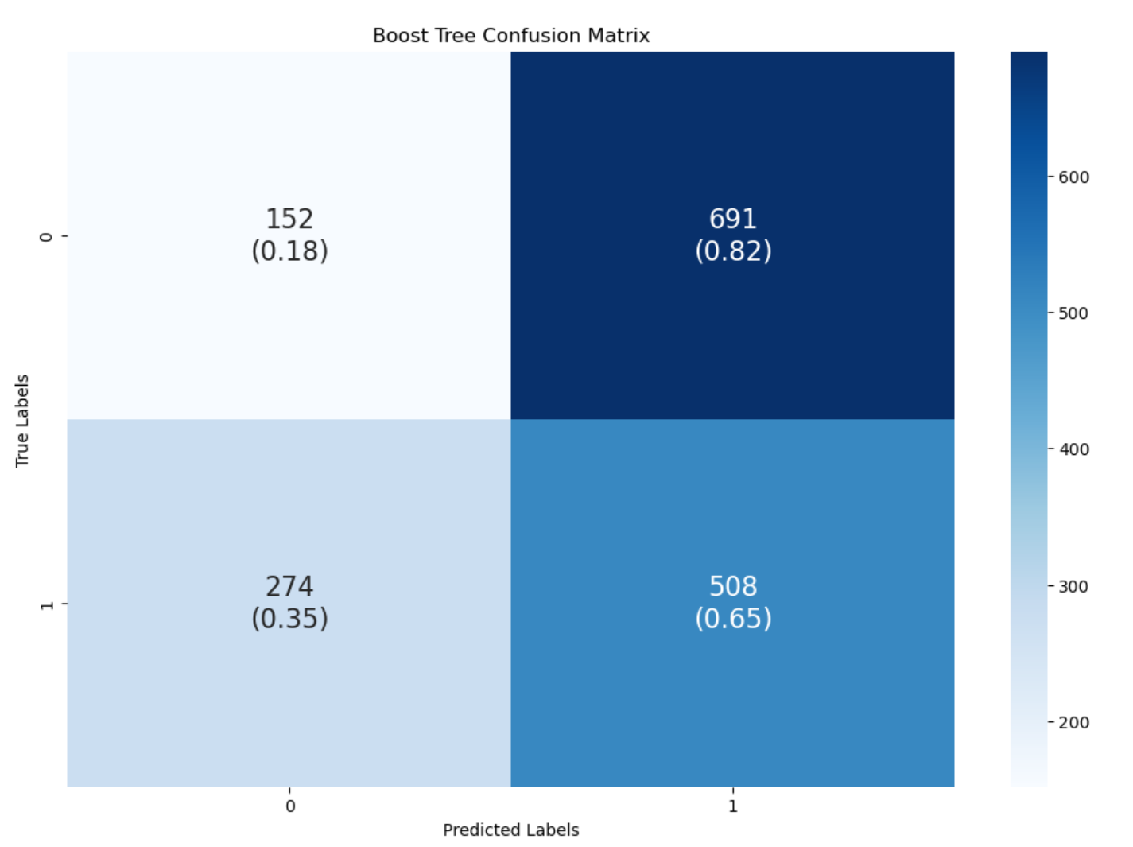
Best Boost Tree
Best parameters
Number of Estimators: 100
Maximum depth: 5
Learning Rate: 0.5
Accuracy = 0.41
Negative Predicted Value = 0.357

Slide 21
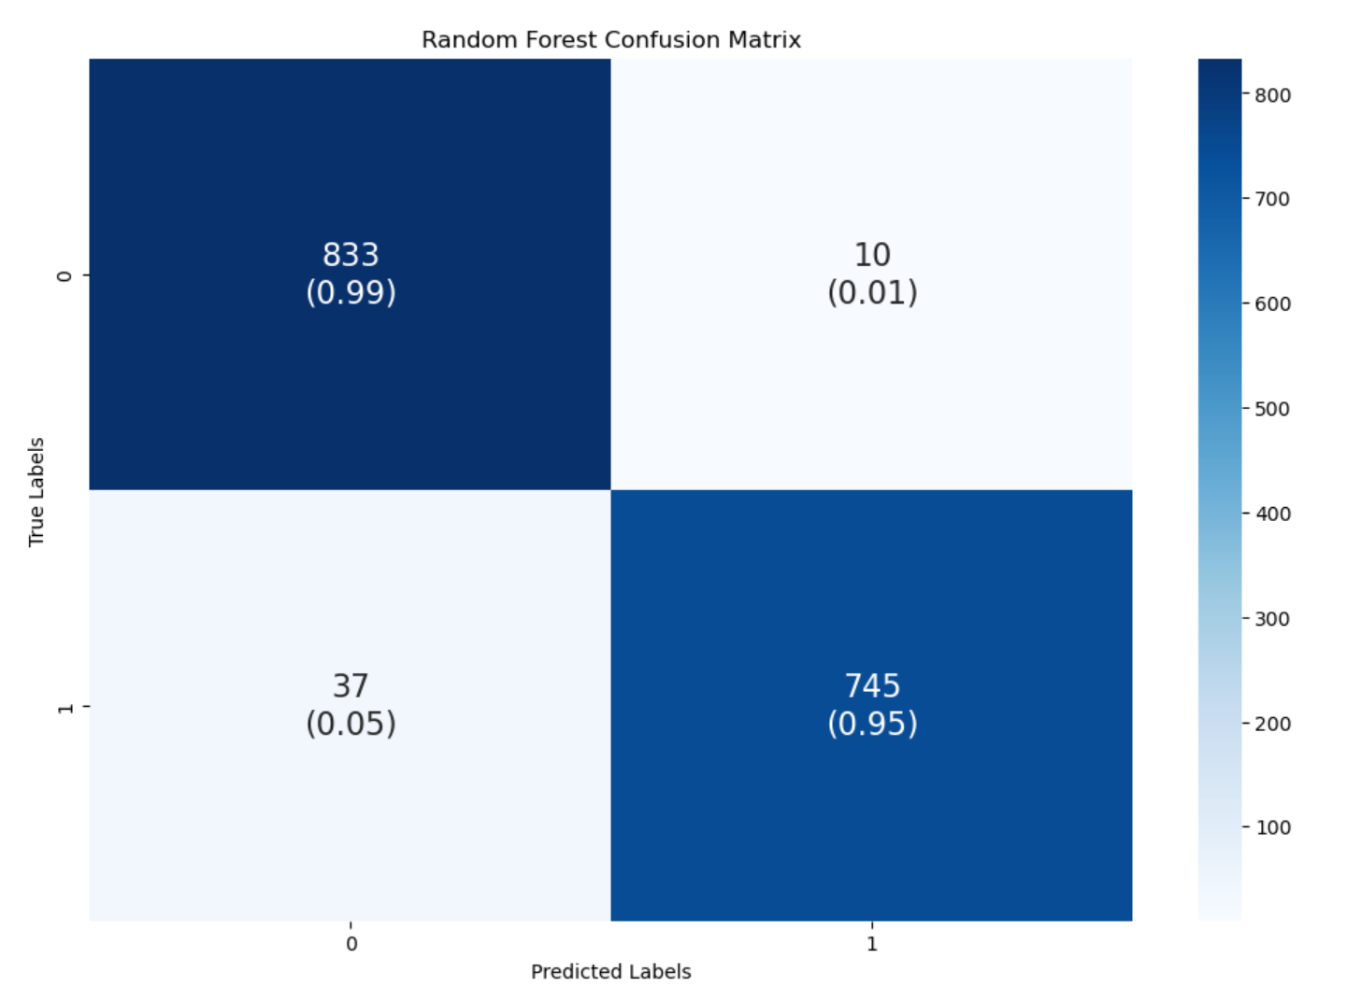
Recommend Random Forest
Best parameters
Number of Estimators: 50
Maximum depth: 5
Accuracy = 0.97
Negative Predicted Value = 0.957

Slide 22
05
Application

Slide 23
Design Idea
When people happen to see a mushroom and wonder if it is edible, they can use our application to recognize toxicity
The application provides instant feedback on the toxicity of the mushroom based on the models we trained
The application mentions the high accuracy rate (97%) of the recognition system in identifying toxic mushrooms
The interface is easy to read and easy to understand

Slide 24
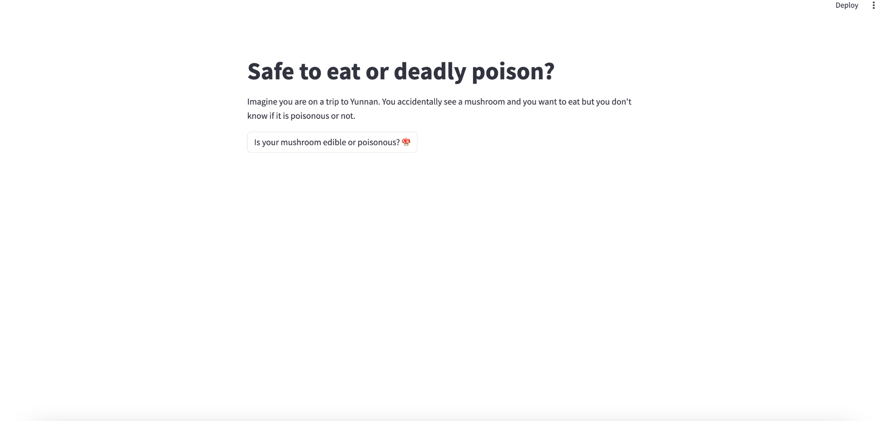
Streamlit Application
· A streamlit Application was made to help people recognize the toxicity of mushrooms and help reduce accidents

Slide 25
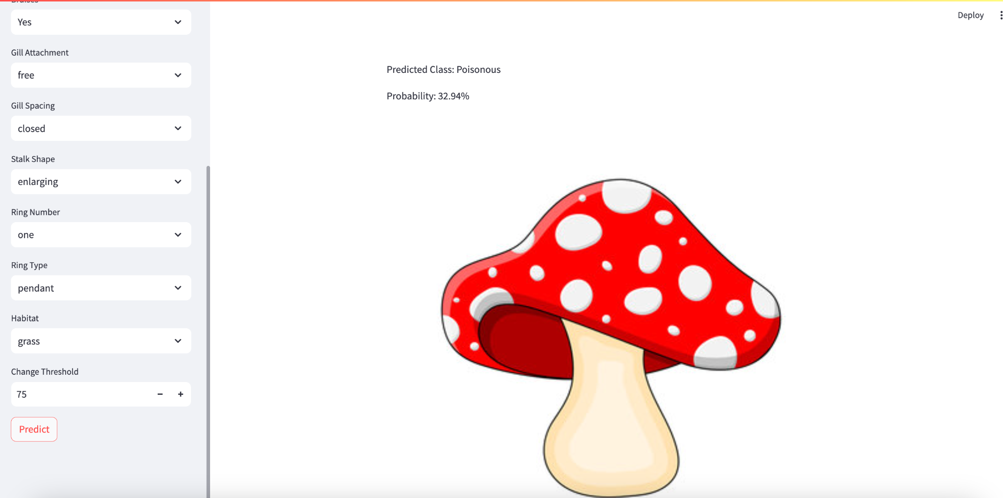
Streamlit Application
· A streamlit Application was made to help people recognize the toxicity of mushrooms and help reduce accidents

Slide 26
Conclusion
06

Slide 27
Our Methodology Summary
Model
Application
StreamLit
(We focus on user experience)
Based on the test of Linear Regression, Support Vector Machine(SVM), Random Forest, Decision Tree and XGBoost, we use Random Forest as our final solution

Slide 28
Our Preliminary Plan
Test out the apps we design and seek feedback from users
Further optimize our StreamLit app and design the UI/UX
1
2
3
Seeking more potential models with higher performance

Slide 29
Thank You！
-Sino dragon

